Slide 1


Data Analytics For Social Buzz

Slide 2


Today's agenda
Project recap
Problem
The Analytics team
Process
Insights
Summary

Slide 3

Due to the rapid growth of Social Buzz and its need to adapt to its global scale, the advisory firm, Accenture has started a 3 months project to handle the following tasks:
An audit of their big data practice
Recommendations for a successful IPO
An analysis of their content categories that highlights the top 5 categories with the largest aggregate popularity
Project Recap

Slide 4

Problem
Unable to manage over 100,00 daily content, all of which are unstructured data.
What are the top content categories with the highest aggregate popularity?

Slide 5



Anthonia Udomoh
Data Analyst
The Analytics team
Marcus Rompton
Senior Principle
Andrew Fleming
Chief Technical Architect

Slide 6
Process
1
Understanding the Data
2
Data Cleaning
3
Data Modelling
4
Data Analysis
5
Share Insights

Slide 7

Insights
Total Reaction to Animal Posts
1897
Unique Categories
16
Month with the Most Posts
May

Slide 8
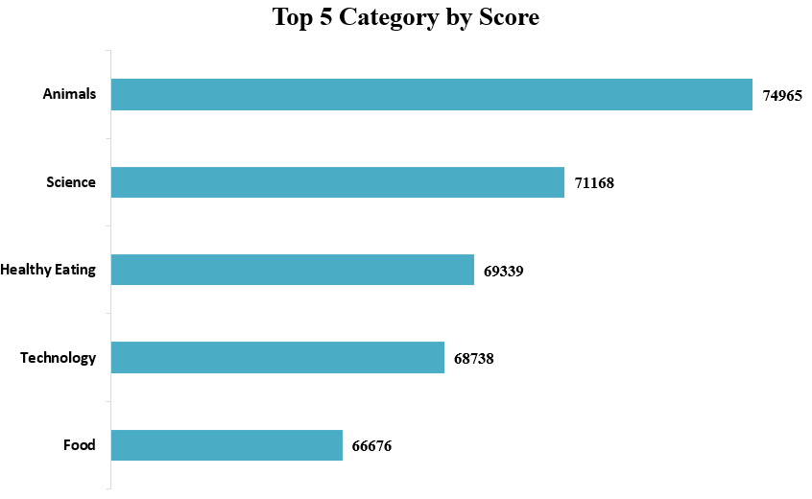

Slide 9
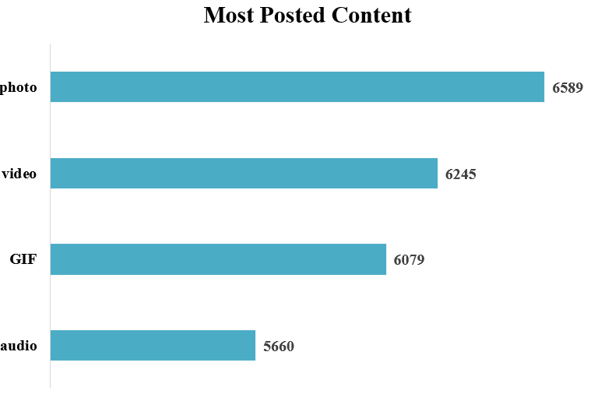
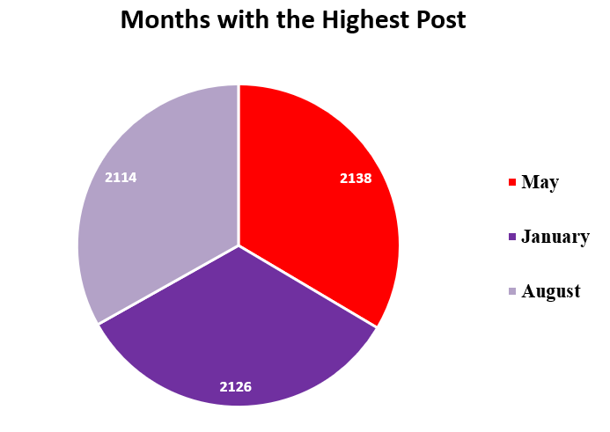

Slide 10

From the data analysis done, Animal & Science are the top categories with Photos being the most content type in Social Buzz, followed by Videos, showing that users relate more with real-life experiences.
Also having Food & Healthy Eating on the top 5 categories could spark collaborations with brands associated with “Healthy Living” thereby utilizing the database available and creating more user engagement
Summary

Slide 11
Thank you!
ANY QUESTIONS?

